Slide 1
Tour Booking Site

Slide 2
Frontend : ASP. Net
Backend : C#
Database : SQL Server(client)
Developed By : Karmarajsinh Gadhethad

Slide 3
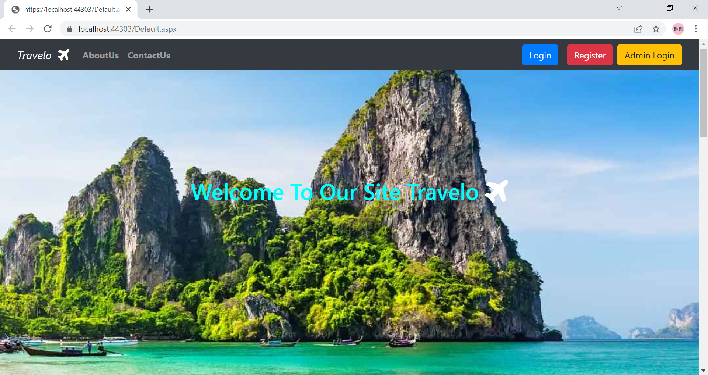
This is home page when user go on site this page load in browser.

Slide 4
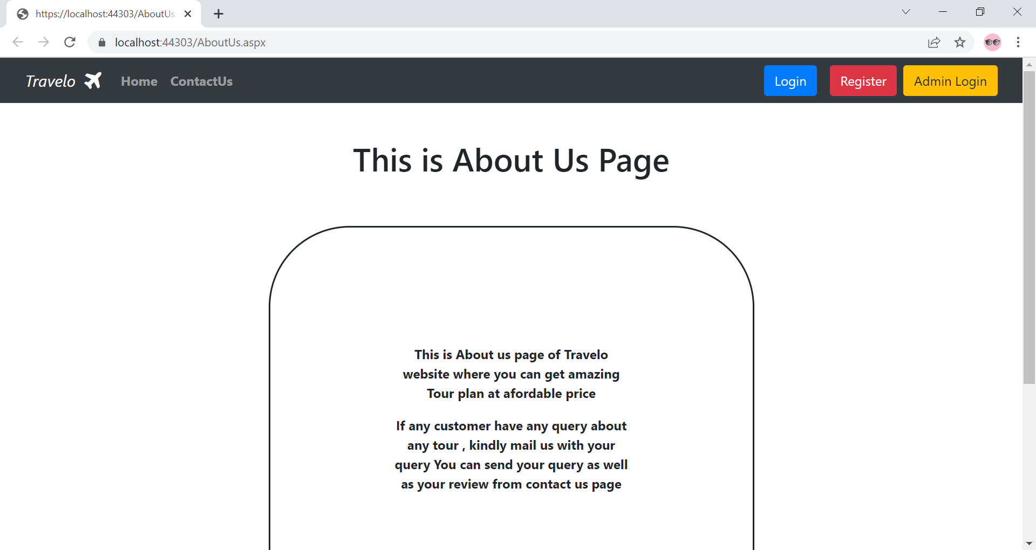
This is About Us page user can get information about this website.

Slide 5
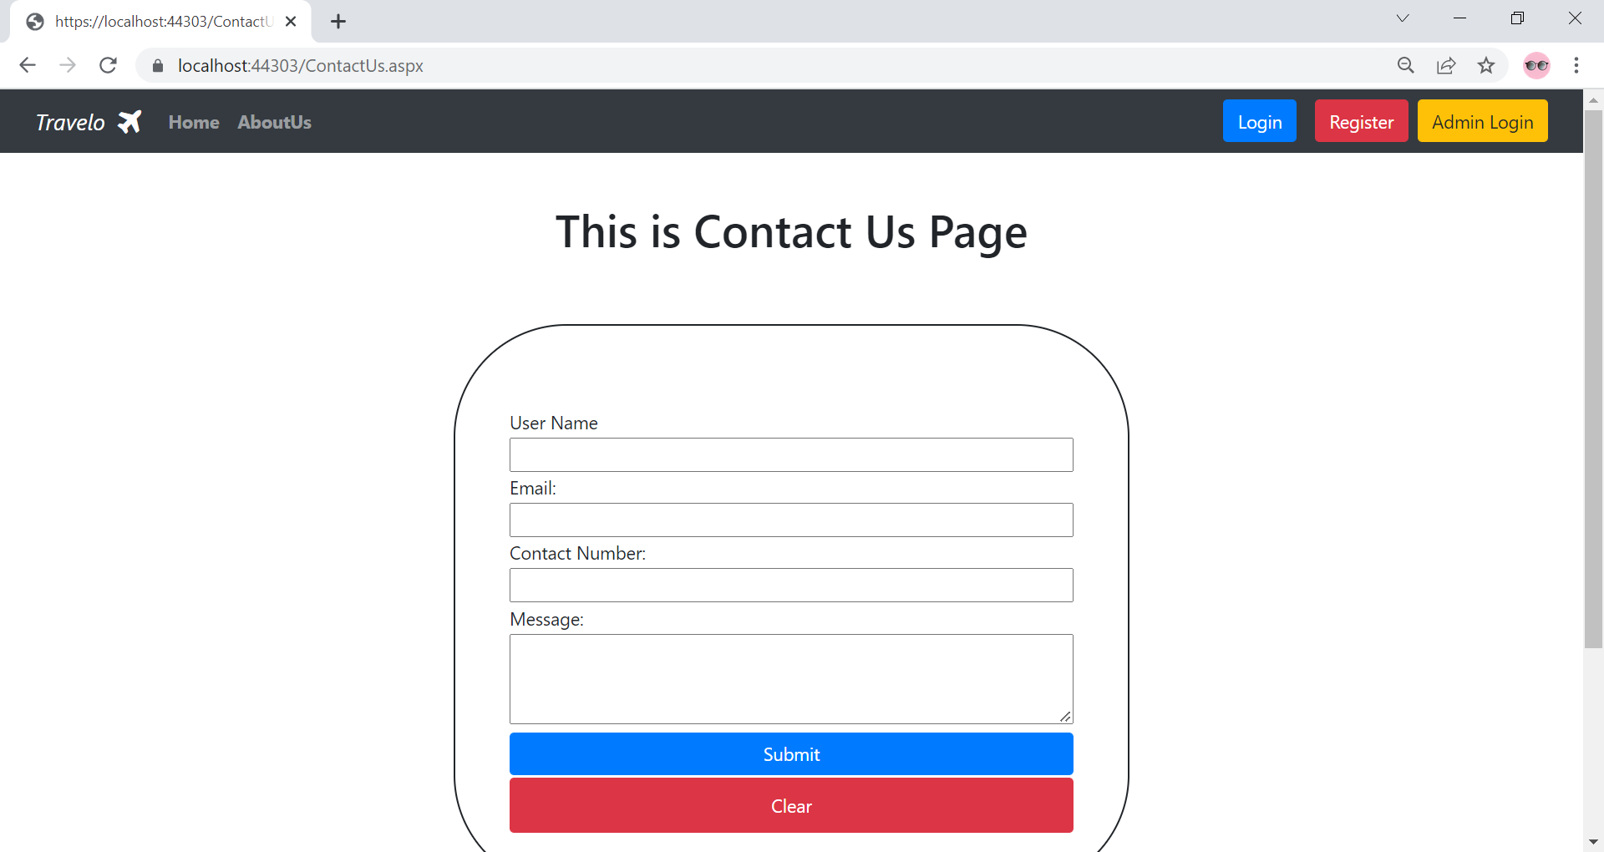
This is contact us page where user can send message to admin for any query and review.

Slide 6
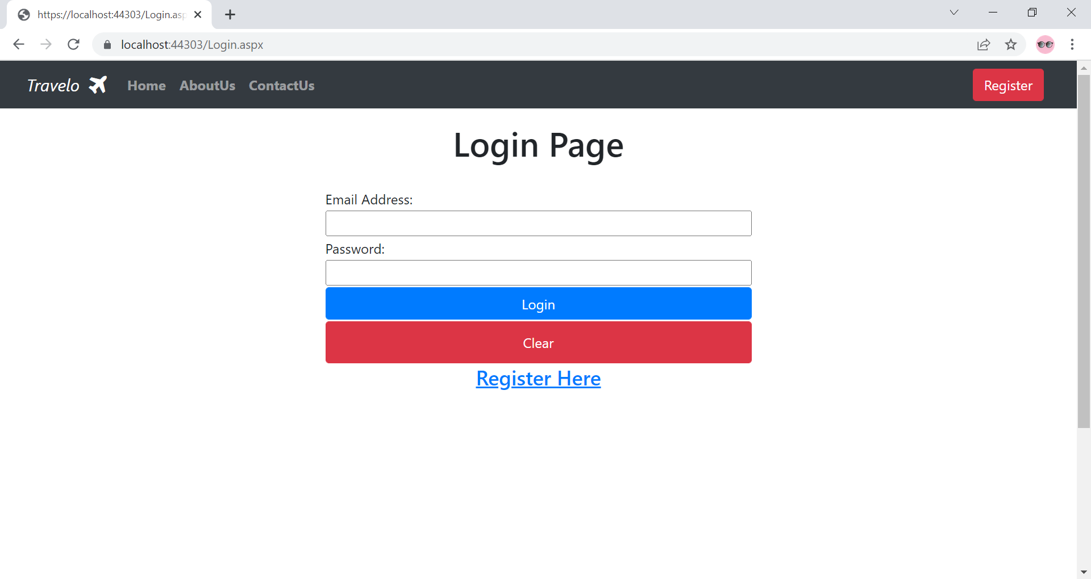
This is login page where user can login if they are registered.

Slide 7
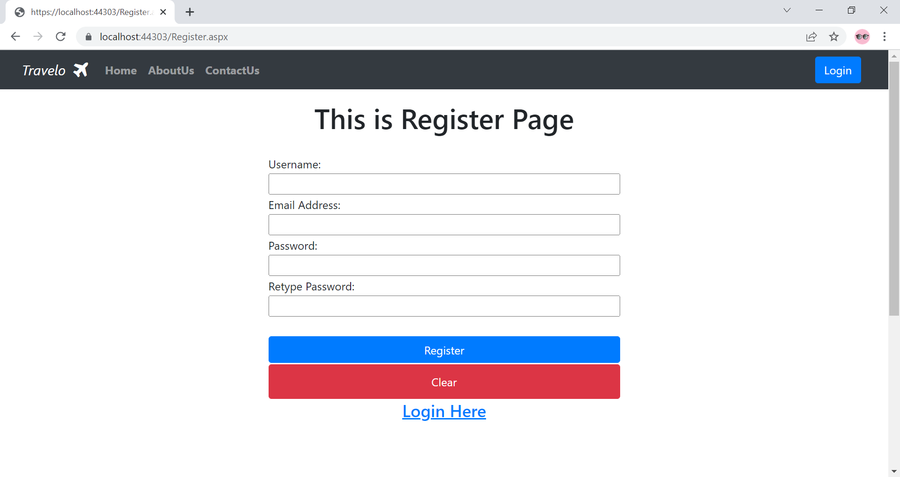
This is register page where user can register if user already registered then they not allowed to registered again.

Slide 8
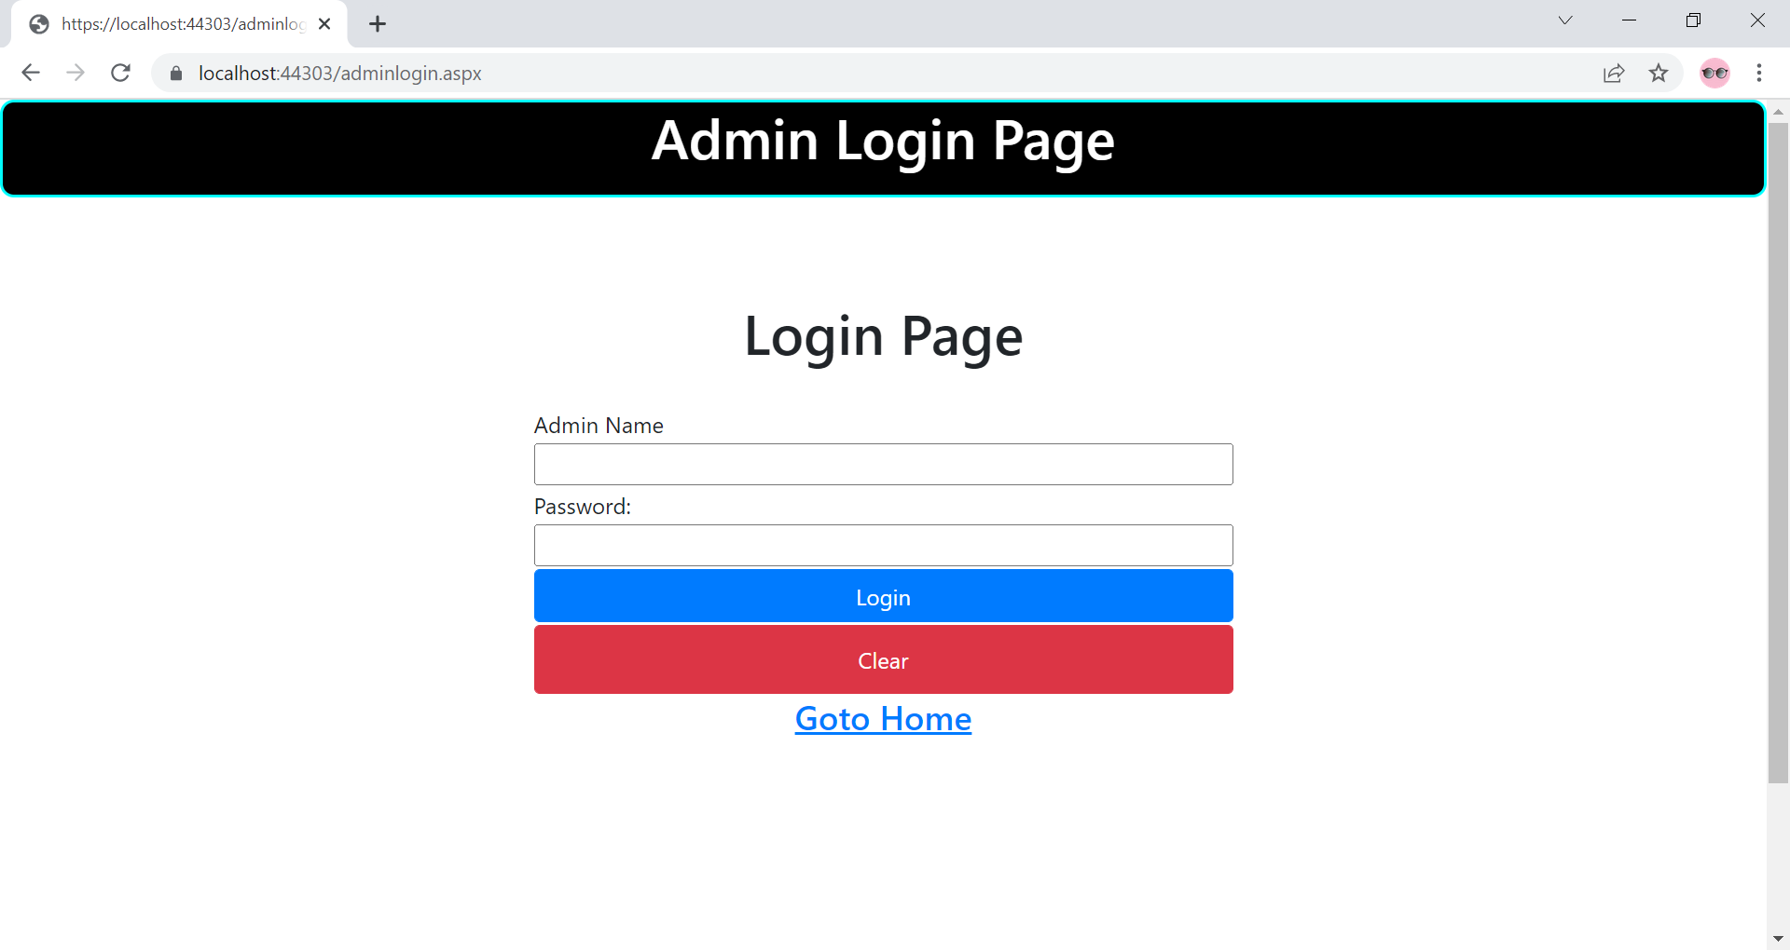
This is Admin Login page where admin can login and manage this site.

Slide 9
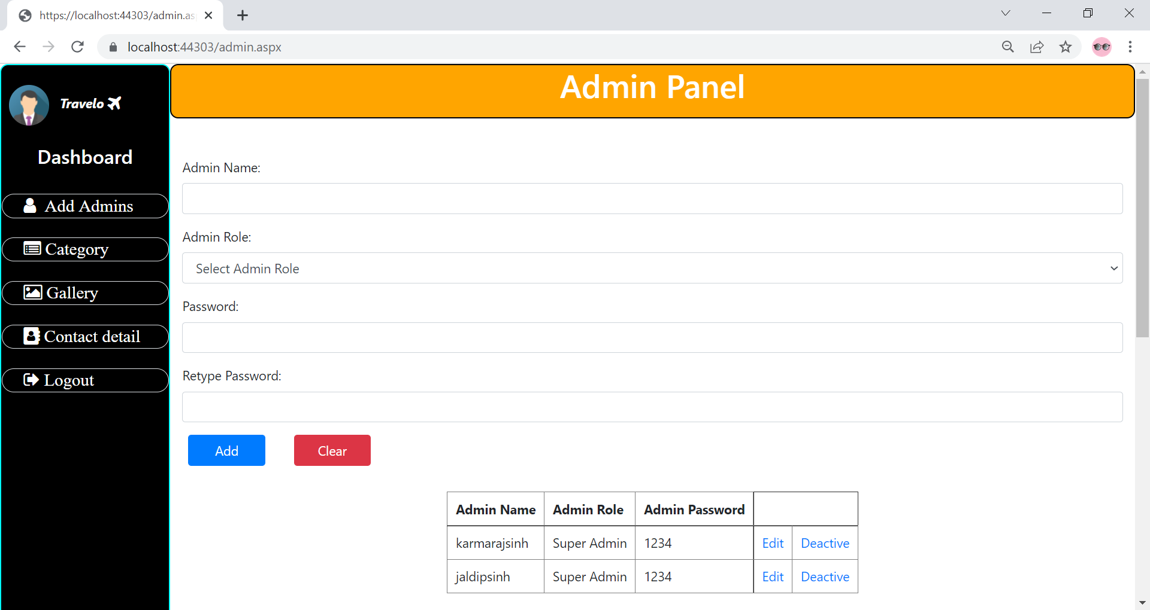
This is admin panel where admin can add new admin , category, and gallery image and also edit it.

